Slide 1

Chapter 1:
Introduction to R Programming for Data Science
Notes:
https://www.powershow.com/view4/6deca5-MTg3Z/Data_Analysis_Using_R_1_Introduction_to_the_R_language_powerpoint_ppt_presentation
https://slideplayer.com/slide/13771452/
n

Slide 2
Getting Data into R

Slide 3
Objectives
Manipulate the basic data types in R
Manipulate numeric and textual data in R
Chapter1- Importing Datasets

Slide 4
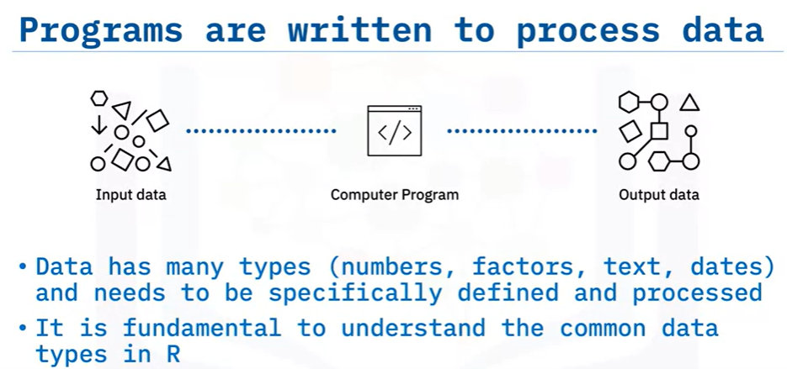
Data types
Data has many types (numbers, factors, text, dates) and needs to be specifically defined and processed
R has a wide variety of data types including scalars, vectors (numerical, character, logical), matrices, dataframes, and lists.
Programs are written to process data
Chapter1- Importing Datasets

Slide 5
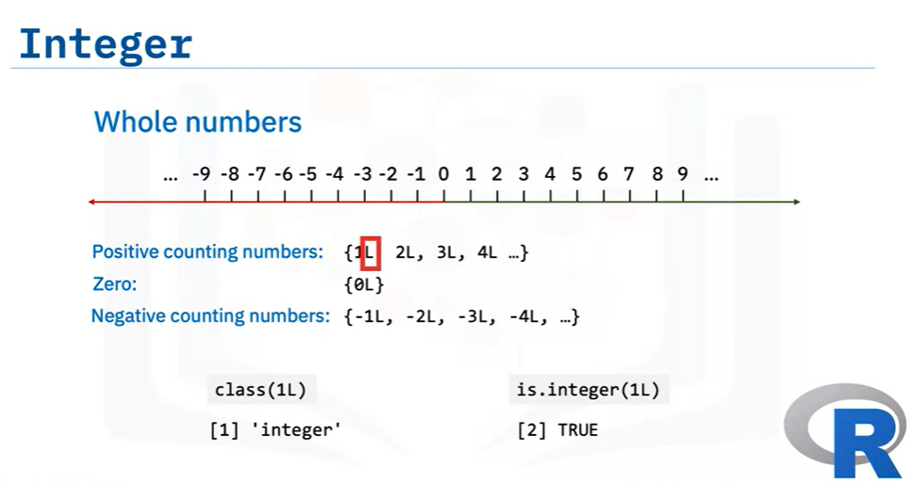

Basic data types
Interger
Chapter1- Importing Datasets

Slide 6
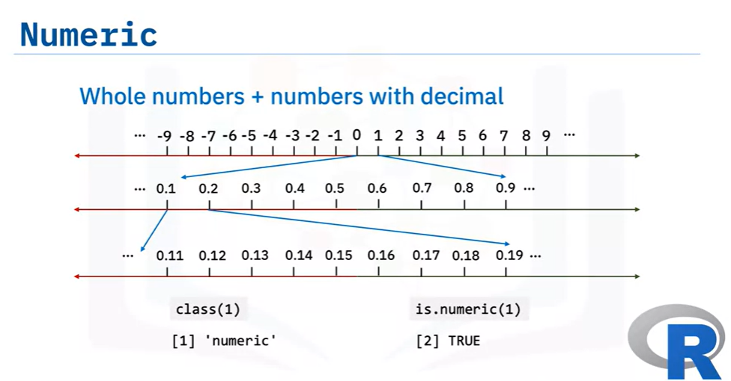


Basic data types
Numeric
Chapter1- Importing Datasets

Slide 7
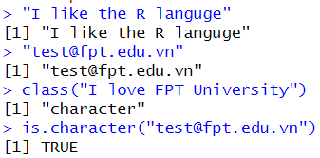

Basic data types
Character
  Textual data
Logical
  Boolean data: TRUE, FALSE
Chapter1- Importing Datasets

Slide 8
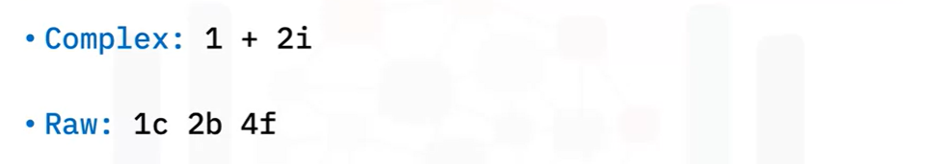
Other data types
Chapter1- Importing Datasets

Slide 9
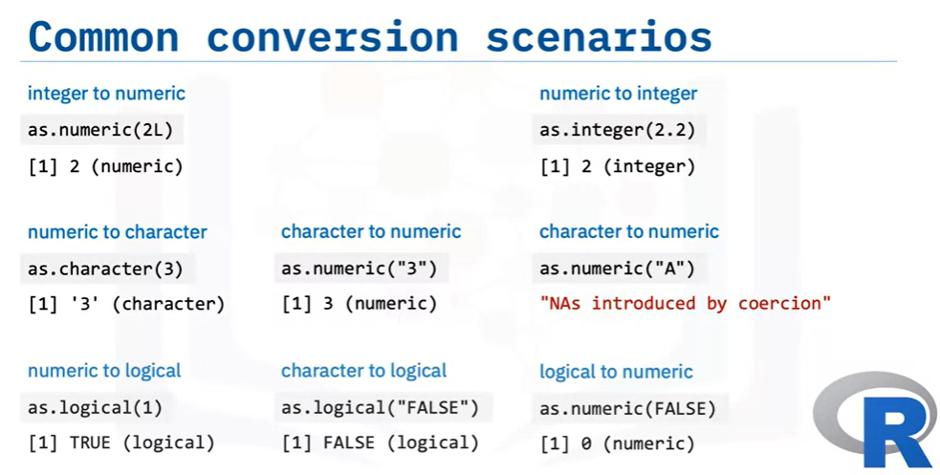
Data type conversion
Chapter1- Importing Datasets

Slide 10
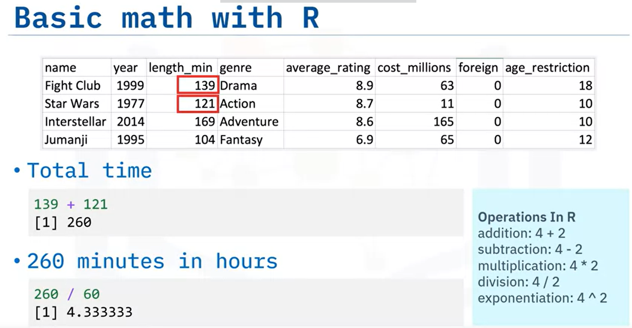
Math, Variables, and Strings
Chapter1- Importing Datasets

Slide 11
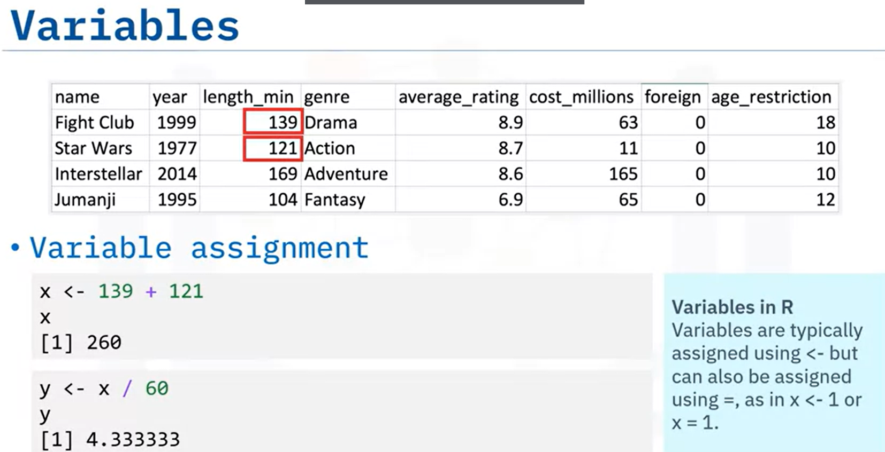
Math, Variables, and Strings
Chapter1- Importing Datasets

Slide 12
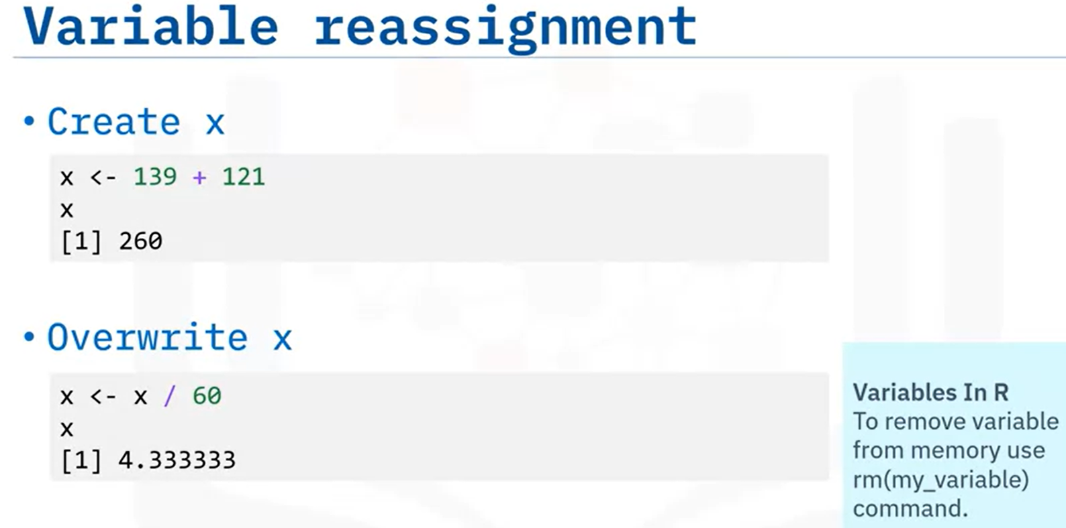
Math, Variables, and Strings
Chapter1- Importing Datasets

Slide 13
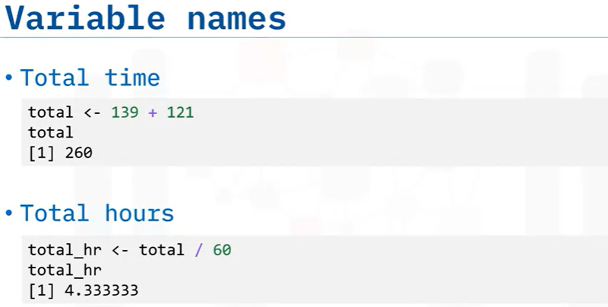
Math, Variables, and Strings
Chapter1- Importing Datasets

Slide 14
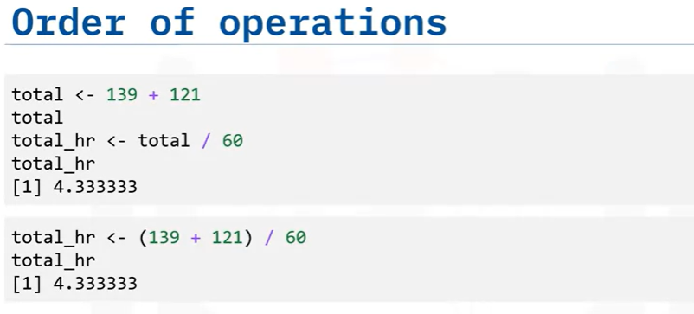
Math, Variables, and Strings
Chapter1- Importing Datasets

Slide 15
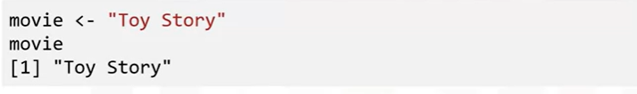
Math, Variables, and Strings
Chapter1- Importing Datasets

Slide 16

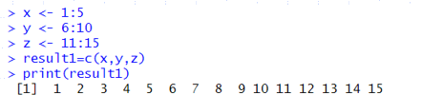
Concatenating data: c() function
c(): R function combines multiple values into a vector or list.
Basic R Syntax: c(value1, value2)
Example:
Chapter1- Importing Datasets

Slide 17
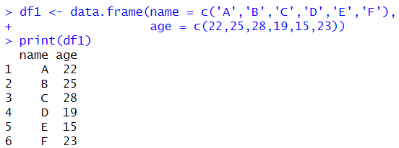
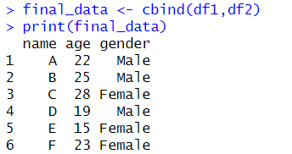
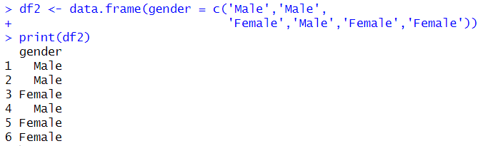
Concatenating data: cbind() function
cbind ():
Merges two data frames together given that the number of rows in both the data frames are equal.
Can append vectors, matrices or any data frame by columns.
Chapter1- Importing Datasets

Slide 18

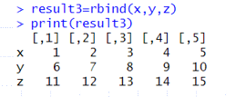
Concatenating data: rbind() function
rbind ():
Merges two data frames together given that the number of rows in both the data frames are equal.
Can append vectors, matrices or any data frame by columns.
Chapter1- Importing Datasets

Slide 19
Summary
At this point in the course, you know:
The four most common data types in R are integer, numeric, character, and logical.
You can use the class() function and the is.integer(),
is.numeric(), is.character(), and is.logical() functions to determine the data type.
You can convert some data types to other data types using the as.integer(), as.numeric(), as.character(), and as.logical()
functions.
Chapter1- Importing Datasets

Slide 20
Q & A
Chapter1- Importing Datasets

